Slide 1

Linear and Mixed Circuits
Engr. Muhammad Waqas

Slide 2
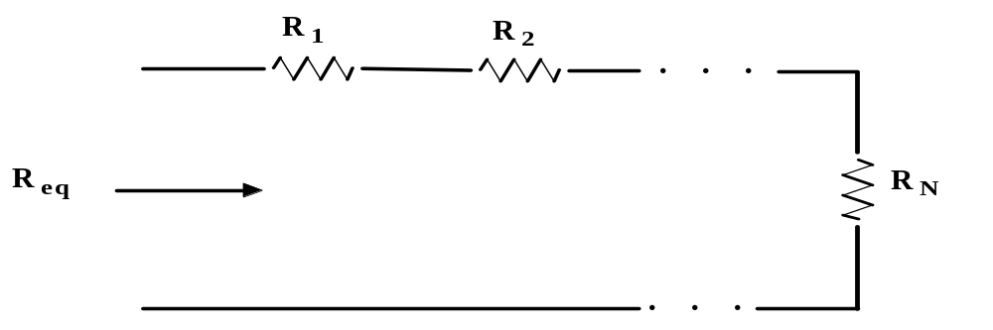
Equivalent Resistance:
We know the following for series resistors:
R_{eq} = R₁ + R₂ + . . . + R_{N}

Slide 3
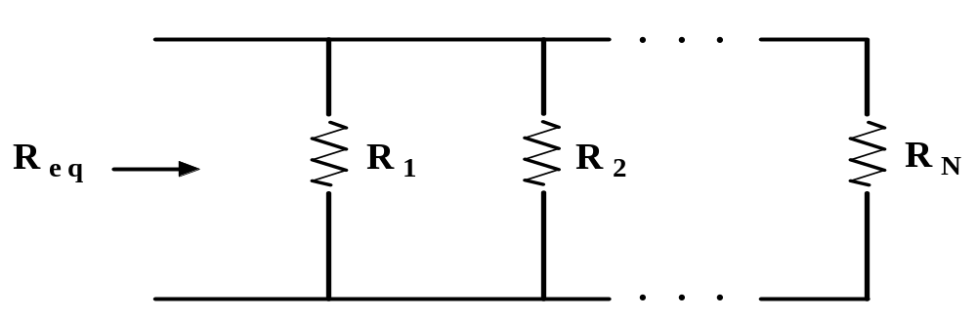
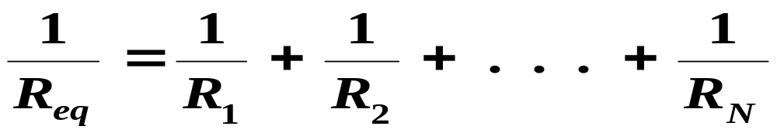
Equivalent Resistance:
We know the following for parallel resistors:

Slide 4
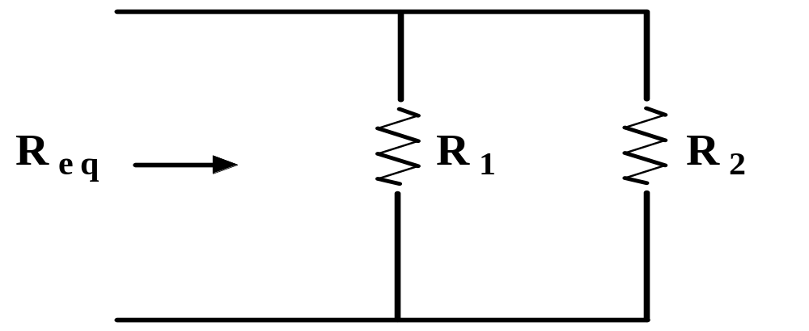
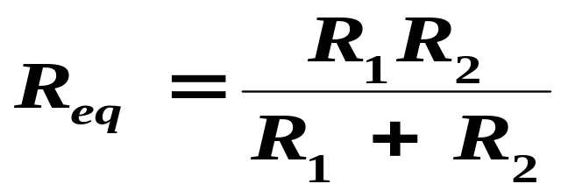
Equivalent Resistance:
For the special case of two resistors in parallel:
If both resister are equal then formula will be change accordingly

Slide 5
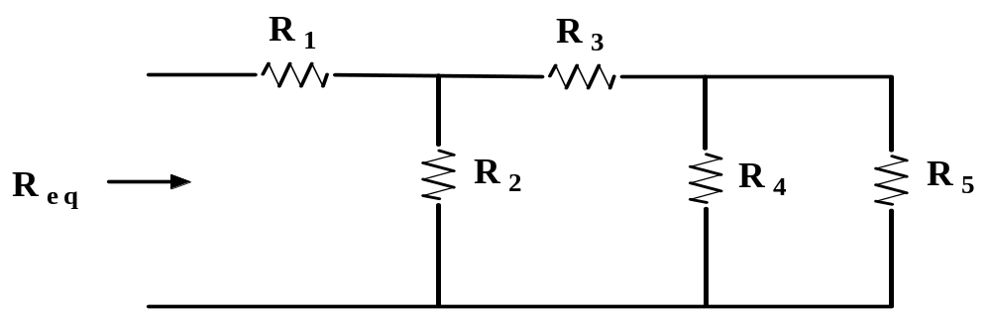
Equivalent Resistance:
Resistors in combination.
Combination waly case batttry l extreme opposite say strat karna hai
By combination we mean we have a mix of series and
Parallel. This is illustrated below.
Double side say connect ho rhi ho to parallel k method say karna hai aghr ik side say connect ho rhi hai to series waly method say sove karna hai
To find the equivalent resistance we usually start at
the output of the circuit and work back to the input.

Slide 6
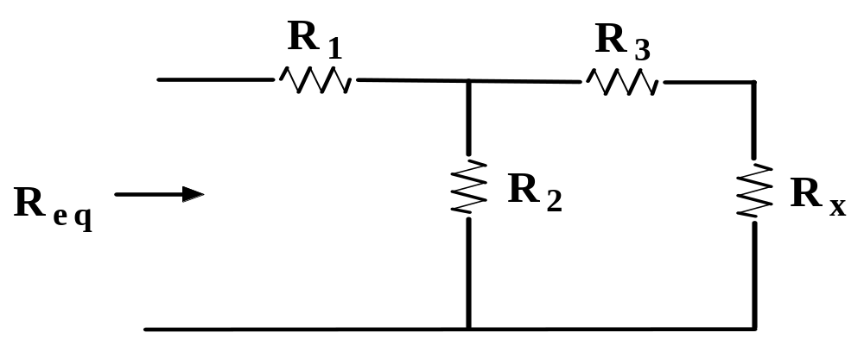
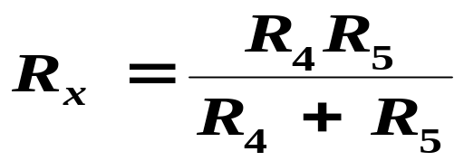
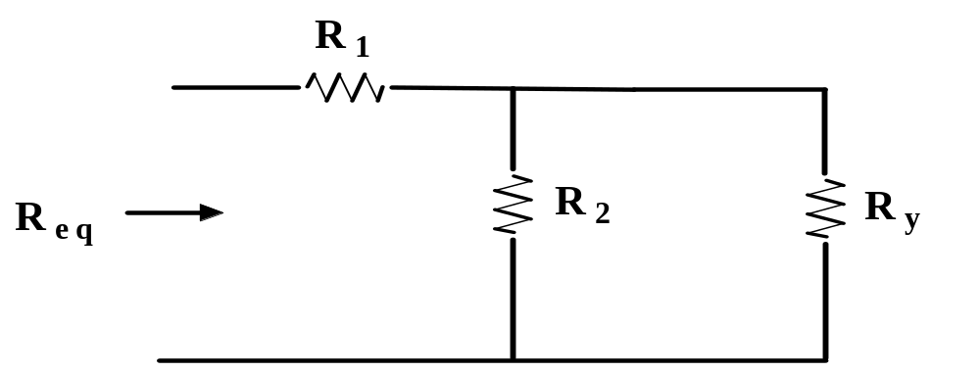
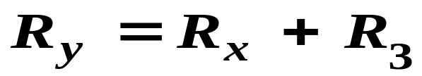
Equivalent Resistance:
Resistors in combination.

Slide 7
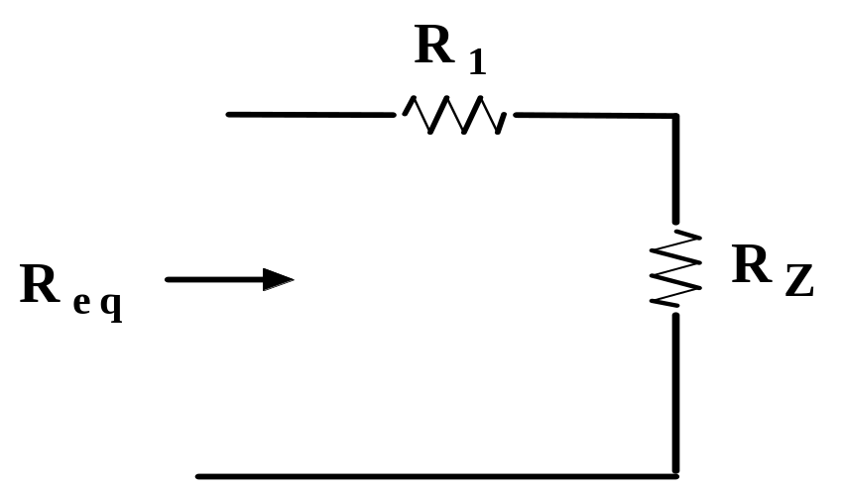

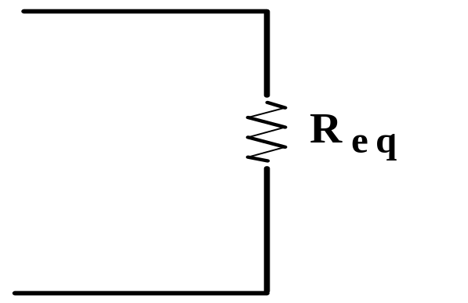

Equivalent Resistance:
Resistors in combination.

Slide 8
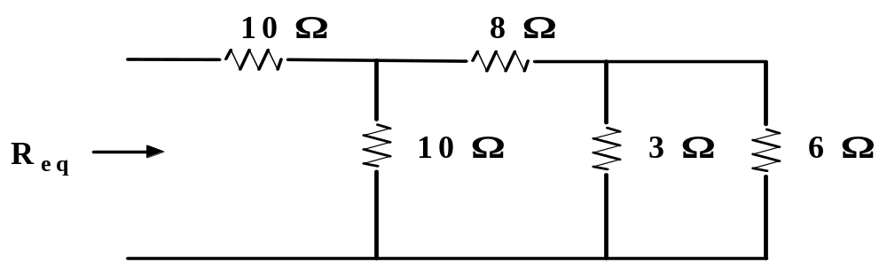
Equivalent Resistance:
Resistors in combination.
It is easier to work the previous problem using numbers than to
work out a general expression. This is illustrated below.
Example 5.1: Given the circuit below. Find R_{eq}.
7

Slide 9
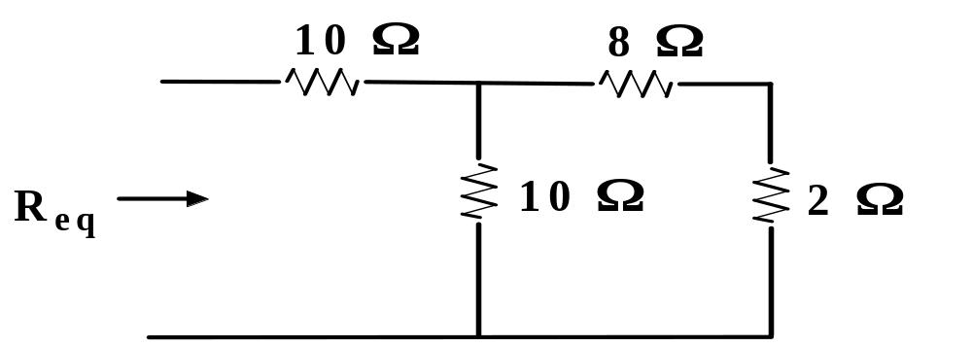
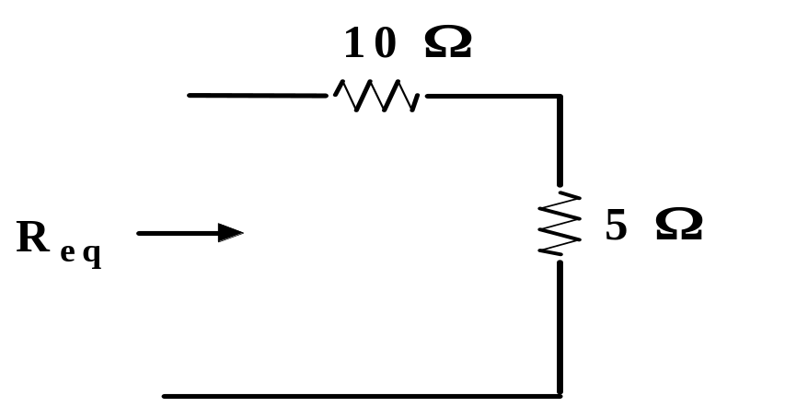

Equivalent Resistance:
Resistors in combination.
.
We start at the right hand side
of the circuit and work to the left.
Ans:

Slide 10
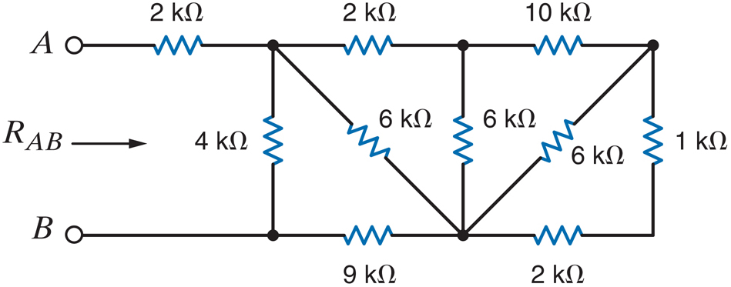
Solve Your Self
ZERO-Grade Quiz
Ye jo 3rd side hoti hai is ko as a parallel accept karan hai

Slide 11
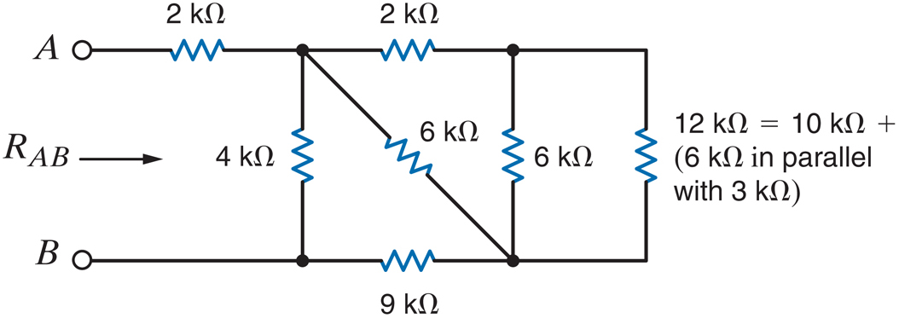
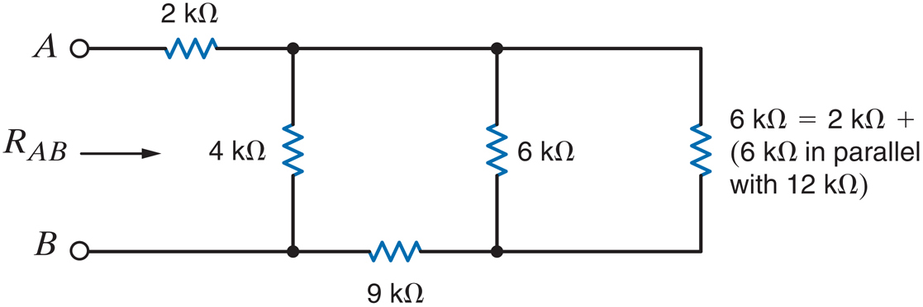

Slide 12
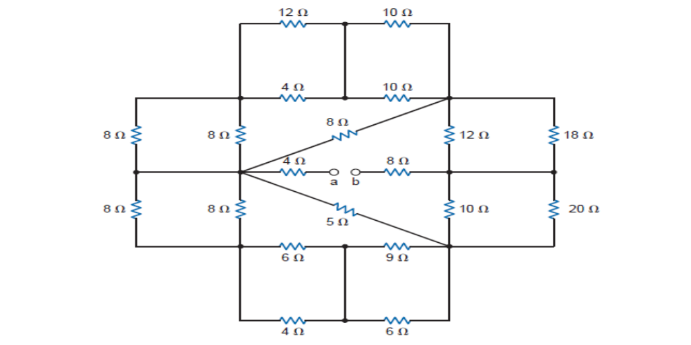
In dono ko parallel accept karna hai

Slide 13
Do some Practice over the Weekend ☺

